Slide 1

Zero Overhead Loop FIR μP SOURINDU CHATTERJEE
ELECTRICAL AND COMPUTER ENGINEERING DEPARTMENT
FLORIDA STATE UNIVERSITY
Spring 2016

Slide 2
INTRODUCTION
ZOL Theory – What it does?
FIR Model Theory
ZOL implementation in FIR Microprocessor Architecture
Processor Development and Simulations
Design Specifications
Demonstration
Future Scope of Research and Limitations
Quiz & Questions
References

Slide 3
ZOL Overview
It is a Hardware abstraction that is provided to make the iteration of segment of code independently for a specified number of times.
The description of the ZOL μP is coded in Very Fast Hardware Description Language….
The key aspect of this hardware extended feature is such that the loop branching takes place in a single clock cycle to execute the loop contents.
Traditionally ZOL is implemented by use of single register for manipulating loop control.
ZOL unit should be ideally of zero cost and there should be no difference on the basis of loop unrolling.

Slide 4
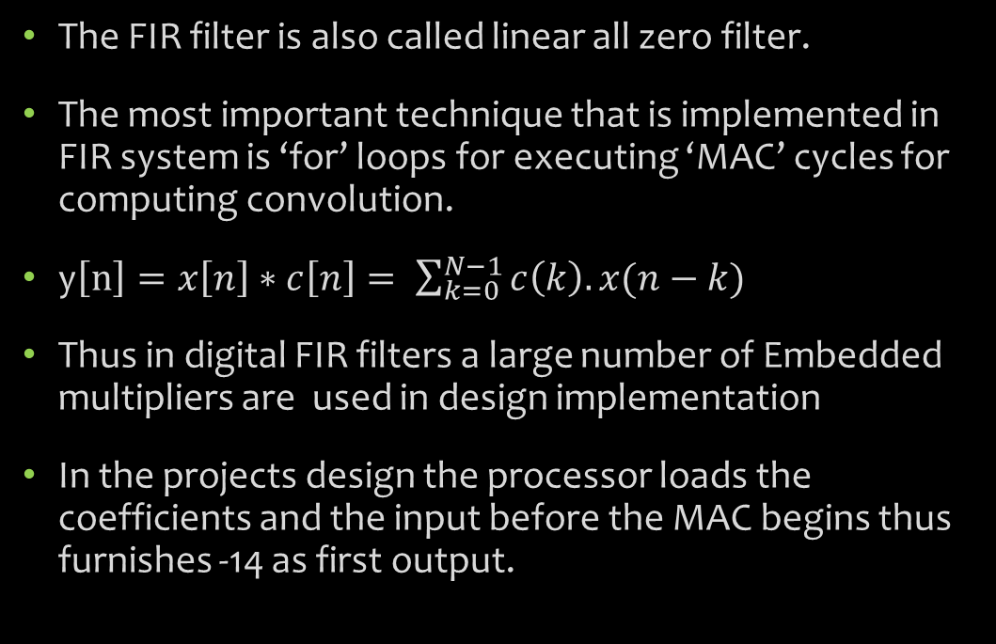
Finite Impulse Response Theory
The FIR filter is also called linear all zero filter.
The most important technique that is implemented in FIR system is ‘for’ loops for executing ‘MAC’ cycles for computing convolution.
y$\left[n\right]=x\left[n\right]∗c\left[n\right]= \sum_{k=0}^{N−1}{c\left(k\right).x(n−k)}$
Thus in digital FIR filters a large number of Embedded multipliers are used in design implementation
In the projects design the processor loads the coefficients and the input before the MAC begins thus furnishes -14 as first output.
c[0] | c[1] | c[2]
-3 | -2 | -1
*
x[2] | x[1] | x[0]
1 | 2 | 3
y[0] | y[1] | y[2]
-3 | -8 | -14

Slide 5
ZOL in FIR Digital Signal Processors
In this design unit the ZERO overhead loop is implemented for the MAC stage of the processor.
The ZOL comes at a cost of clock cycles, where a FIR μp of 100 coefficients takes 100 clock cycles to compute the first accumulated output.
The design also includes a dynamic assignment of filter coefficients length which can change during execution.
There are hardware provision for taking dynamic input during execution and also the filter coefficients can also be modified.
A runtime circular arrangement of the data input is taken into consideration.
x[2] | 1
x[1] | 2
X[0] | 3
x[2] | 2
x[1] | 3
X[0] | 4

Slide 6
Processor Development
Start
Trans
Mac
The State Machine →
Done

Slide 7
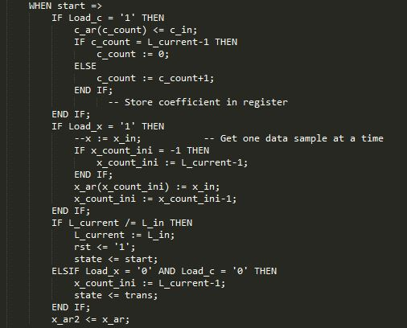
State -> Start

Slide 8
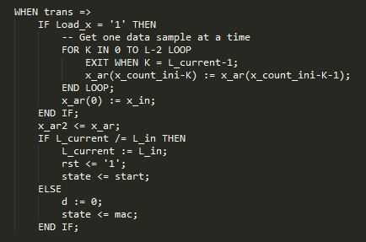
State -> Trans

Slide 9
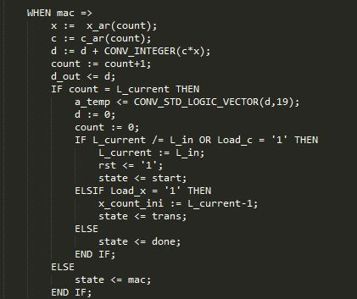
State -> Mac

Slide 10
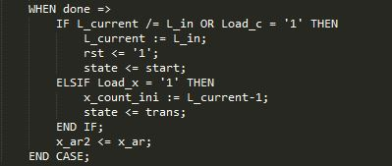
State -> Done

Slide 11
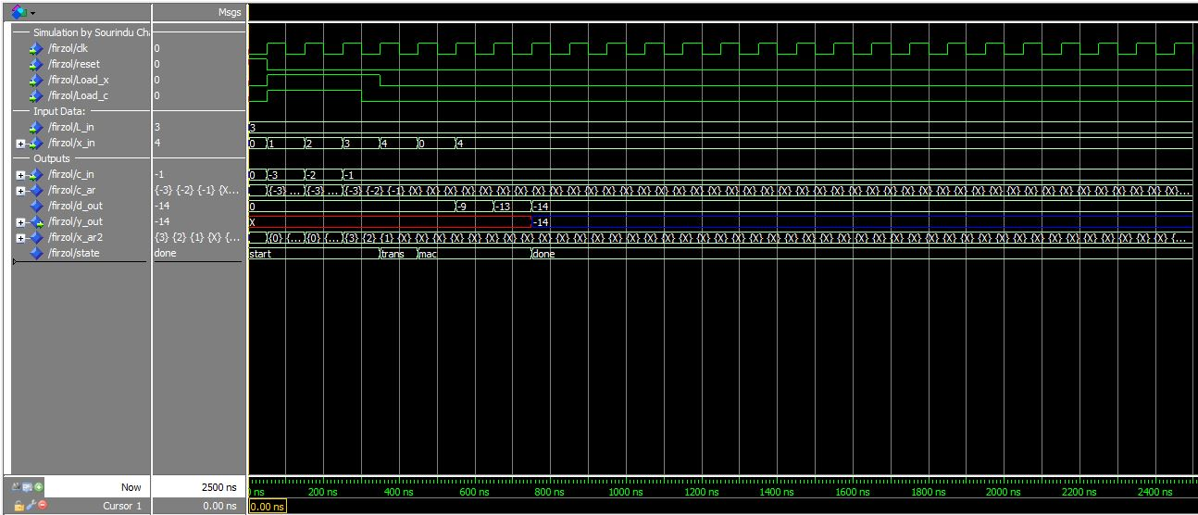
Simulation v1
Simple Mac cycle for output of -14

Slide 12
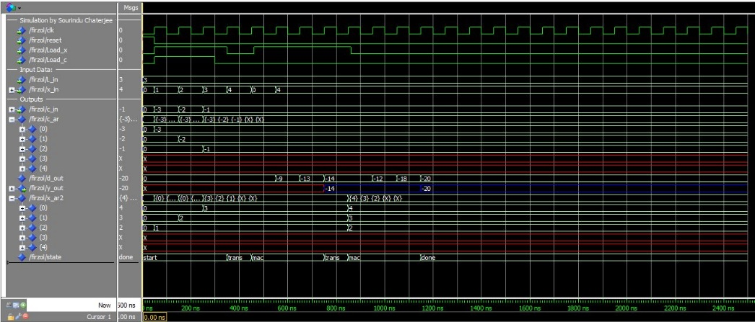
Simulation v2
One Mac cycle and Data Arrangement

Slide 13
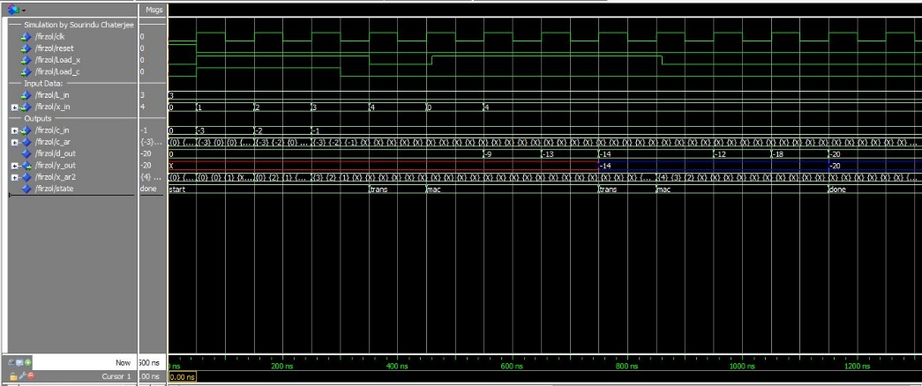
Simulation v3
Loading x input during Mac to get a output of -20

Slide 14
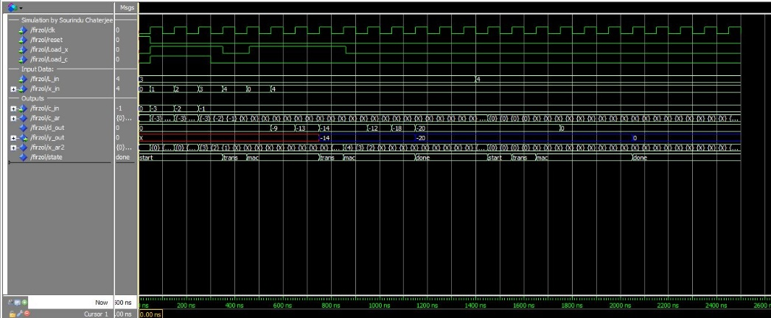
Simulation v4
Changing the dynamic filter length from 3 to 4

Slide 15
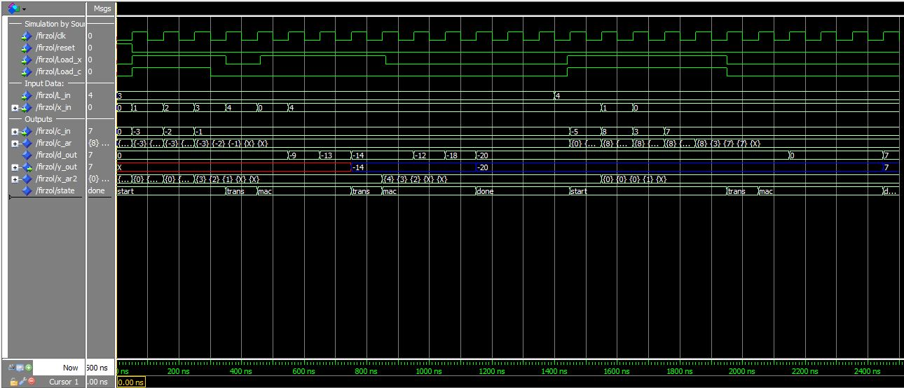
Simulation v5
Taking coefficients and data input to get impulse output

Slide 16
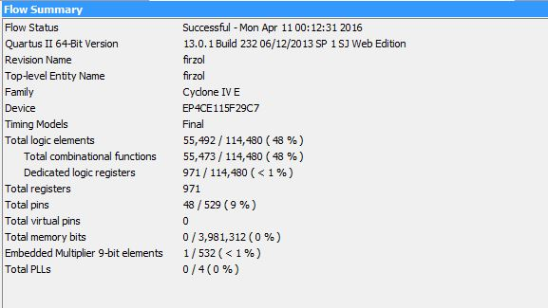

Design Specifications for generic length of 50

Slide 17
DEMONSTRATION

Slide 18
Limitations & Future Prospective
The design is very large in terms of physical hardware and thus makes the cost of fitting the circuit in the FPGA very difficult.
There can be similar ZOL applied to ‘trans’ and ‘start’ state to eliminate the use of looping in the hardware.
The design gives us a right idea of ZOL implementation in hardware for FIR filtering which can act as source for future development.
Lot of research scope is available for development of efficient convolution algorithms for making FIR filtering efficient.

Slide 19
Quiz ????
FIR Filters are non-recursive system.
FIR microprocessor with filter length equal to 3 will run at lest 3 clock cycles to give output.
Sequential assignment of signals are possible within the ‘process’ statement.
Zero Overhead Looping and Loop unrolling are similar feature
A 21 tap linear filter operating at 1 KHz has a delay of 10 milliseconds
False
True
False
False
True

Slide 20
References
U. Meyer-Baese: Digital Signal Processing with Field Programmable Gate Arrays (Springer, 4th edition, 2014).
Zero-overhear loop controller for implementing multimedia algorithms Nikolaos Kavvadias and Spiridon Nikolaidis, Section of Electronics and Computers, Department of Physics Aristotle University of Thessaloniki.
Effective Exploitation of a Zero Overhead Loop Buffer YuhongWang, David Whalleyt, Department of Computer Science, Florida State Universit Gang-RyungUh, SanjayJinturkar, Chris Bums, Vincent Cao, Lucent Technologies,Allentown
Application of Zero Overhead Loop and Address Generator in General Purpose Computing Jinyung Namkoong.
http://microchip.wikidot.com/dsp0201:zero-overhead-loops

Slide 21


QUESTIONS

